Slide 1
Server-side Computing: Application Programming Interface (API)
Task |  | R&D Area
1.1 |  | Data Management
1.2 |  | User Interface and Search
1.3 |  | Hardware & Network
1.4 |  | Data Transfer
1.5 |  | Installation (Containerized)
1.6 |  | Authentication & Authorization
1.7 |  | Federation
1.8 |  | Quality Control & Assurance
1.9 |  | Replication
1.10 |  | Distributed Search
1.11 |  | Metrics
1.12 |  | User Notification
1.13 |  | Long-tail Publication
1.14 |  | Distributed Computation
1.15 |  | Data Citation
2.1 |  | Provenance Capture
2.2 |  | Workflow
2.3 |  | Dynamic Resources
2.4 |  | In situ Analysis
2.5 |  | Machine Learning
2.6 |  | UQ
2.7 |  | Analytical Modeling
2.8 |  | Mobile Apps
Current capability status:
 | Usable
 | Prototype
 | Research activity
Jason Boutte
Lawrence Livermore National Laboratory
2017 Triennial Project Review, Potomac, MD
June 8 – 9, 2017
This work was performed under the auspices of the U.S. Department of Energy by Lawrence Livermore National Laboratory under Contract DEAC52-07NA27344.

Slide 2
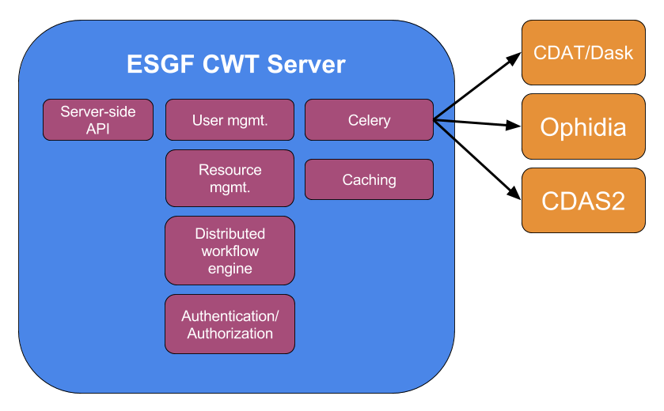
Computer Node (i.e., server-side) architecture
Notes:
Django based Web Processing (WPS) implementation
Stack (Django, Celery, RabbitMQ, Redis, PostgreSQL, THREDDS)
Support multiple computational backends
Climate Data Analytic Service (CDAS2) Nasa
Climate Data Analysis Tools (CDAT) LLNL
Ophidia CMCC
User Management
Resource Management
Access to ESGF data
OAuth2 & MyProxyClient

Slide 3
Server-side API
Designed to work on top of WPS specification
Targets working with gridded data
Provides a standardized interface for client and server
Allows for various implementations of client and server software

Slide 4
End-user API
Written in Python
Implements CWT API
Allows for server-agnostic requests
Abstracts complicated WPS URL requests
Easy to use/understand library
Representations of variable, domain, process as python classes

Slide 5
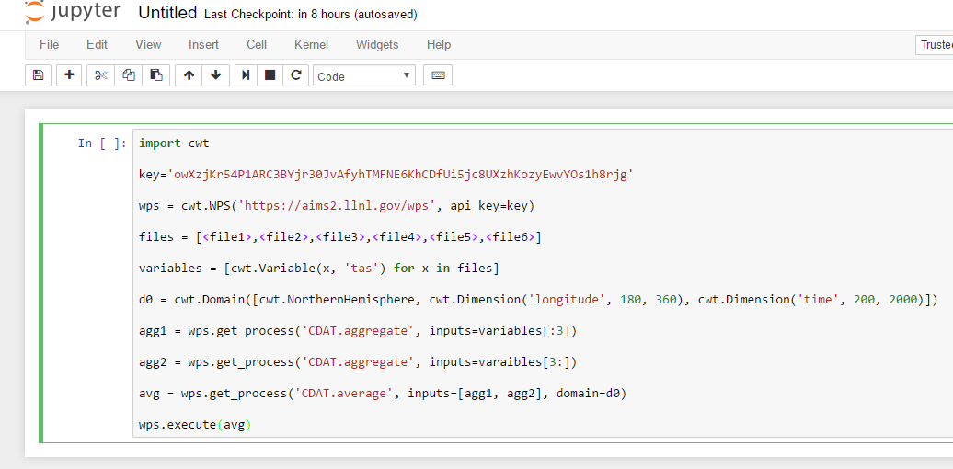
https://aims2.llnl.gov/wps?service=WPS&request=Execute&data_inputs="[variable=[{"uri":<file1>,"id":"tas|m1v0"},{"uri":<file2>,"id":"tas|m1v1"},{"uri":<file3>,"id":"tas|m1v2"},{"uri":<file4>,"id":"tas|m2v0"},{"uri":<file5>,"id":"tas|m2v1"},{"uri":<file6>,"id":"tas|m2v2"}];domain=[{"id":"d0","time":{"start":200,"end":2000,"crs":"values","step":1},"latitude":{"start":90,"end":0,"crs":"values","step":1},"longitude":{"start":180,"end":360,"crs":"values","step":1}}];operation=[{"name":"CDAT.aggregate","input":["m1v0","m1v1","m1v2"],"result":"agg1","domain":"d0"},{"name":"CDAT.aggregate","input":["m2v0","m2v1","m2v2"],"result":"agg2","domain":"d0"},{"name":"CDAT.average","input":["agg1","agg2"],"gridder":{"tool":"esmf","method":"linear","grid":"gaussian~32"}}]]"&api_key=owXzjKr54P1ARC3BYjr30JvAfyhTMFNE6KhCDfUi5jc8UXzhKozyEwvYOs1h8rjg

Slide 6
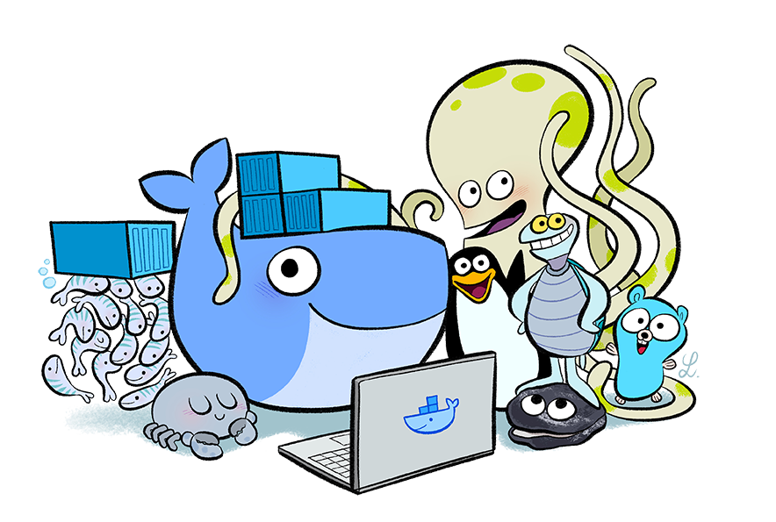
Docker
All services have been “dockerized”
WPS, Celery, CDAS2, THREDDS
Scalability through Docker swarm
Provides reliability
Automatic service recovery
Upgradeability/maintainability
Pre-built images versus installing from scratch or having system images
Capable of running on cloud service (AWS, Google)

Slide 7
Documentation
End-user API documentation on readthedocs
Server-side API documentation on readthedocs
Compute Node documentation on github

Slide 8
Proposed Future Work
Add support for additional computational back-ends
Diagnostics
Machine Learning
Distributed workflow in ESGF
Localize computations to data
Add support for provenance capture

Slide 9
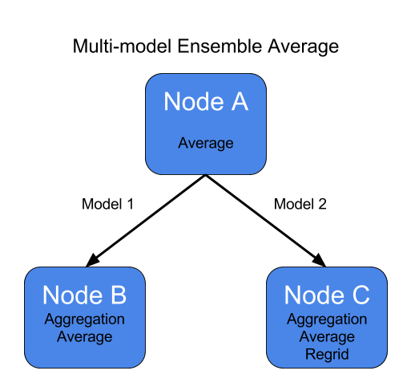

Slide 10
DEMO

